Slide 1

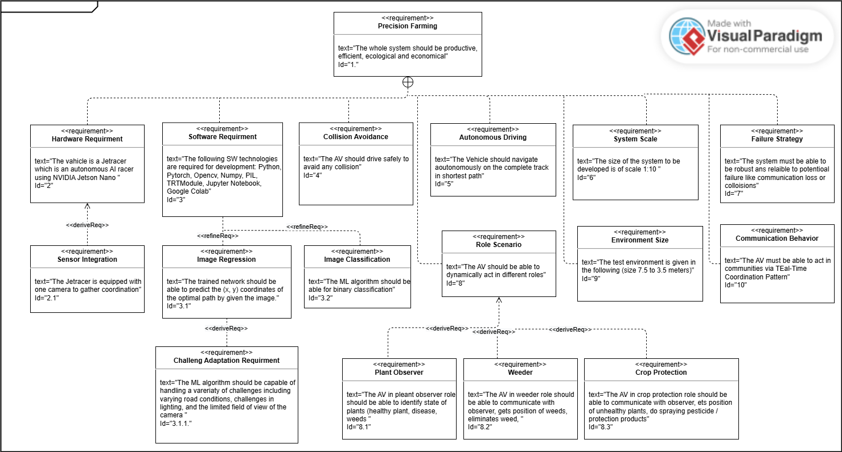
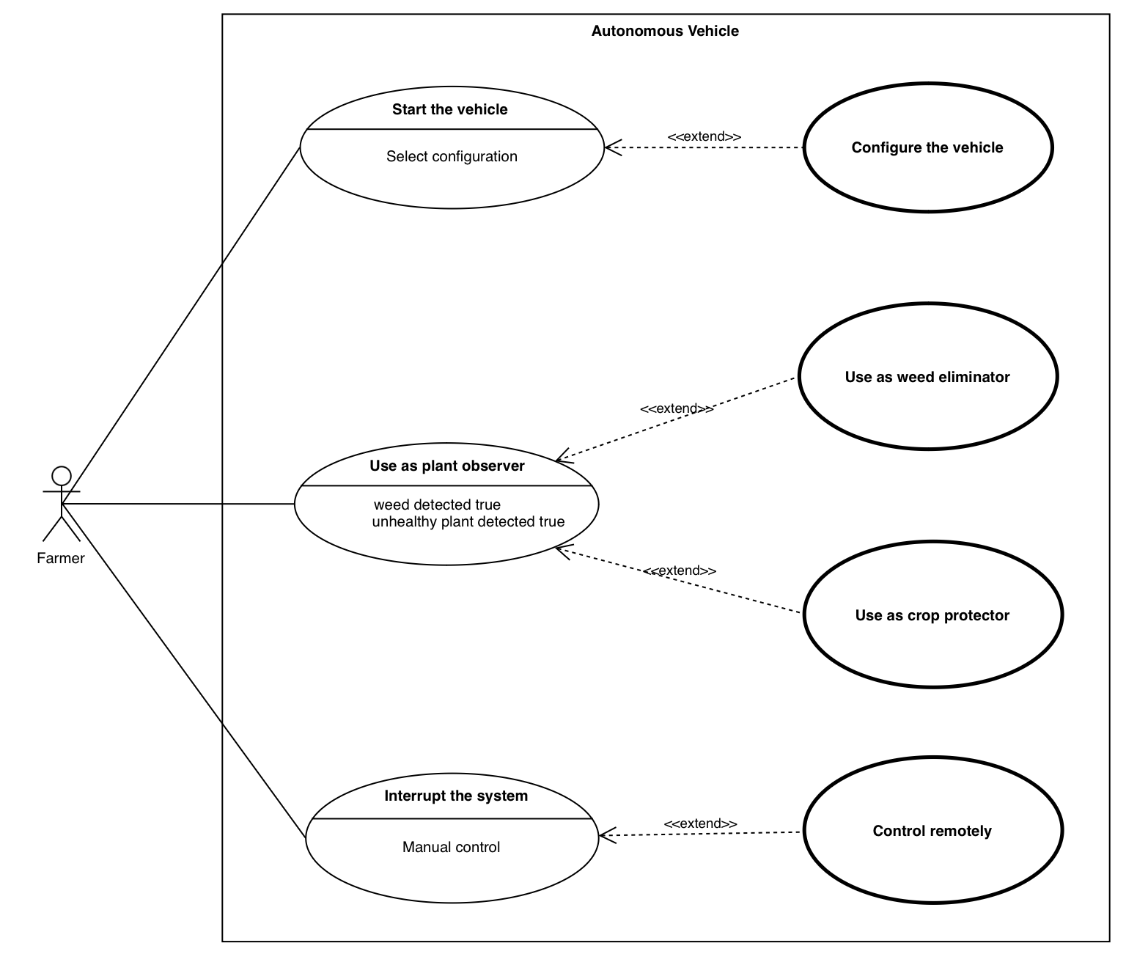
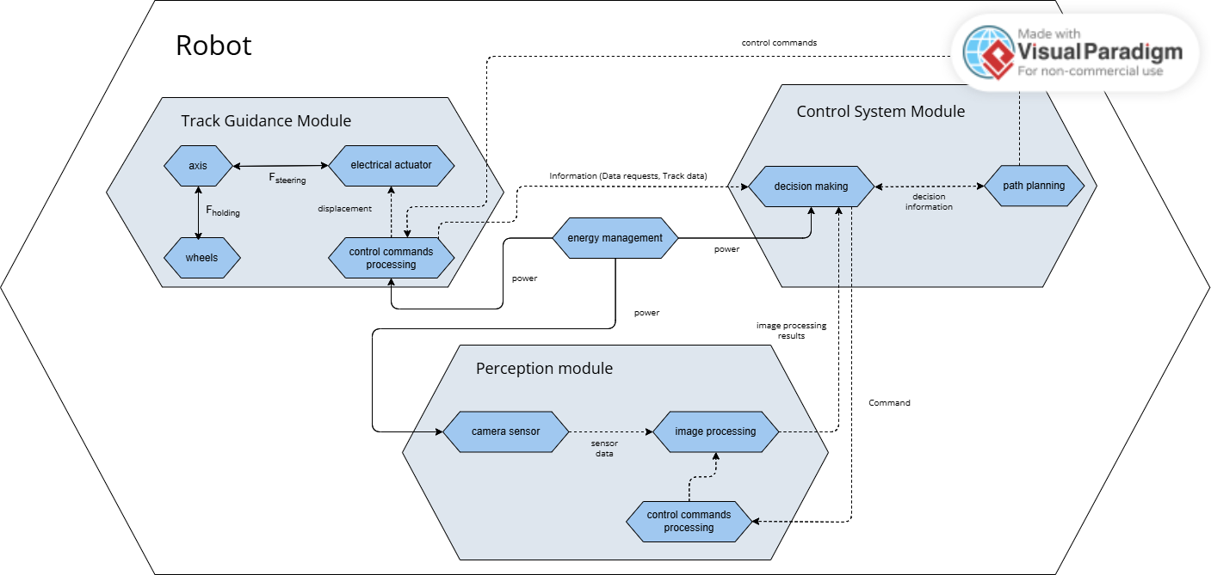
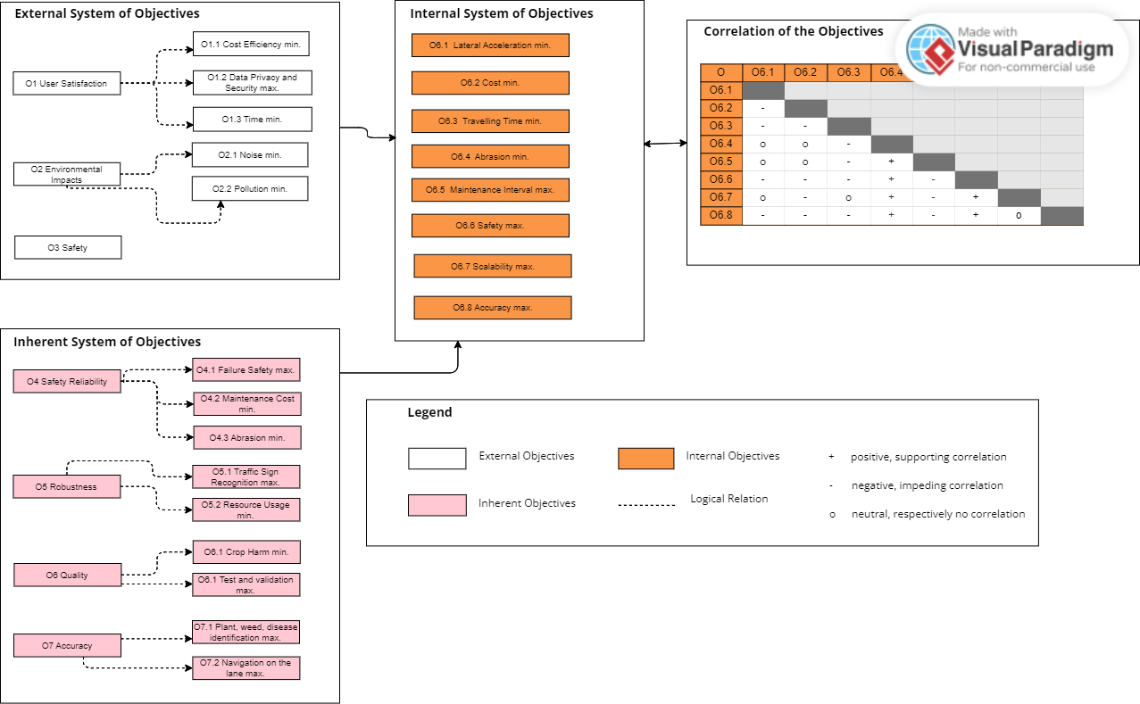
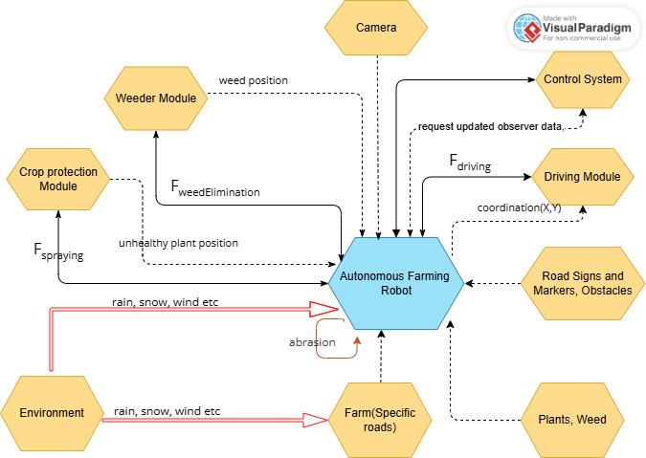

Roghieh Farajialamooti
Ghazaleh Hadian
Tural Hasanov
Gökcer Sönmezocak
Summer School
Embedded Systems Engineering
The Autonomous Future of Agriculture
Requirements
CONSENSE
Application Scenario
Active Structure
System of Objectives
Environment

Slide 2
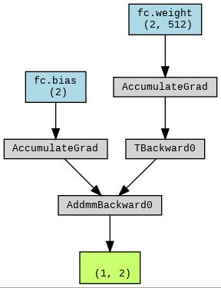
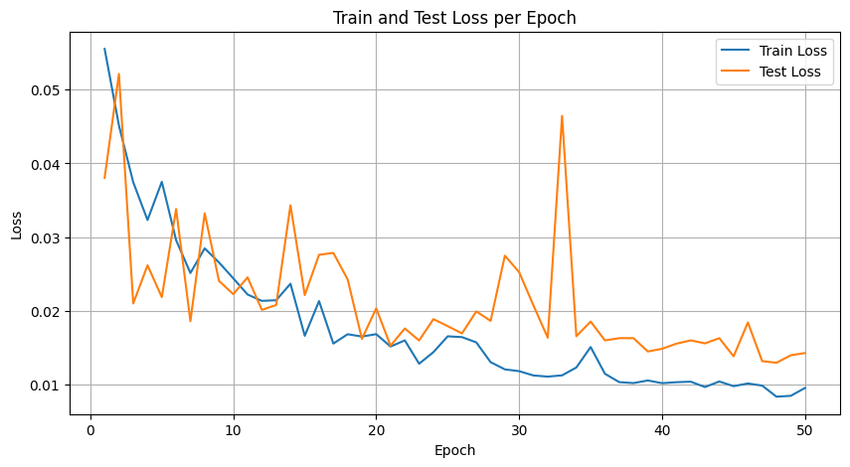
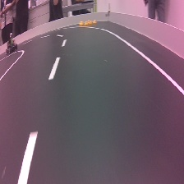
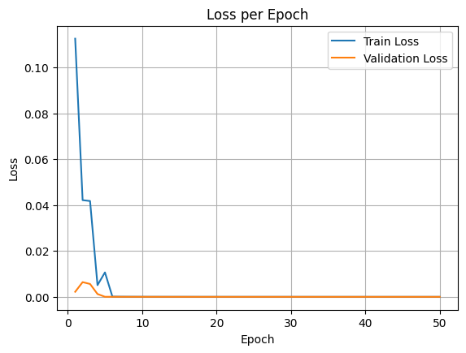
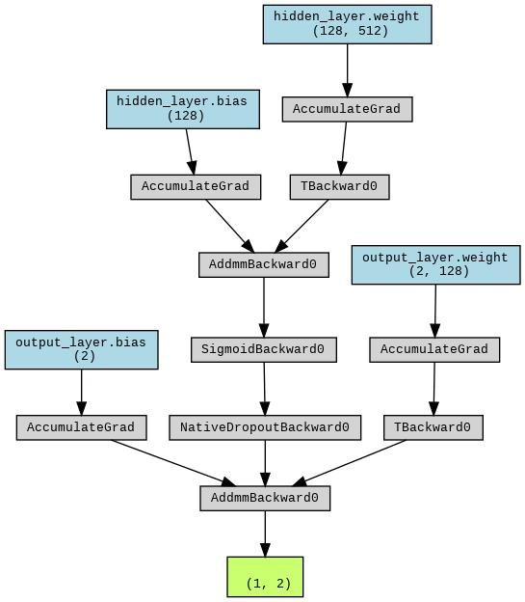
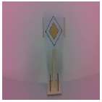
Roghieh Farajialamooti
Ghazaleh Hadian
Tural Hasanov
Gökcer Sönmezocak
Summer School
Embedded Systems Engineering
The Autonomous Future of Agriculture
Preprocessing
Data Augmentation:
Color Jittering
Resize
Convert to Tensor
Reverse Channel
Normalize
Extract X and Y
Data: 2000 Images
Size 224 x 224
Cognitive
Road Following Model
Performance
Performance
Traffic Sign Detection
Model: resnet18
Predicted Class: Priority
Accuracy: 0.996
Precision: 0.993
Recall: 1
F1 Score: 0.976

Slide 3
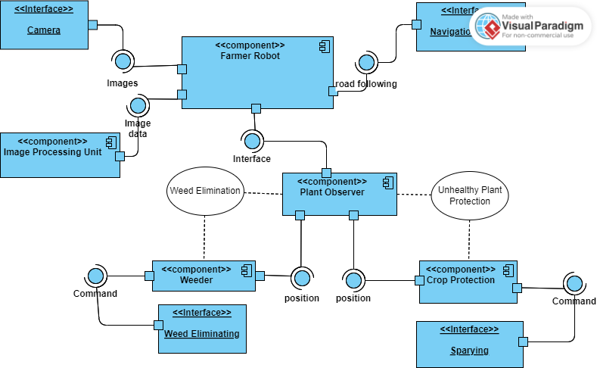
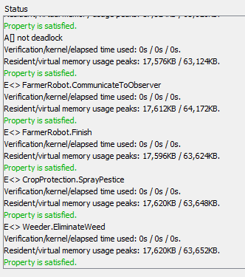
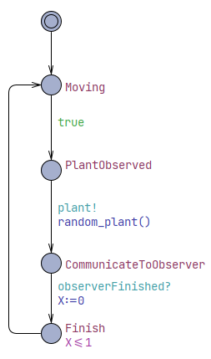
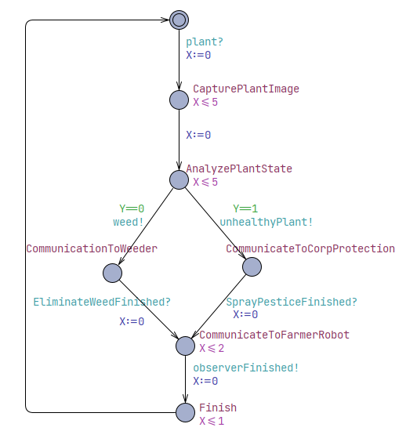
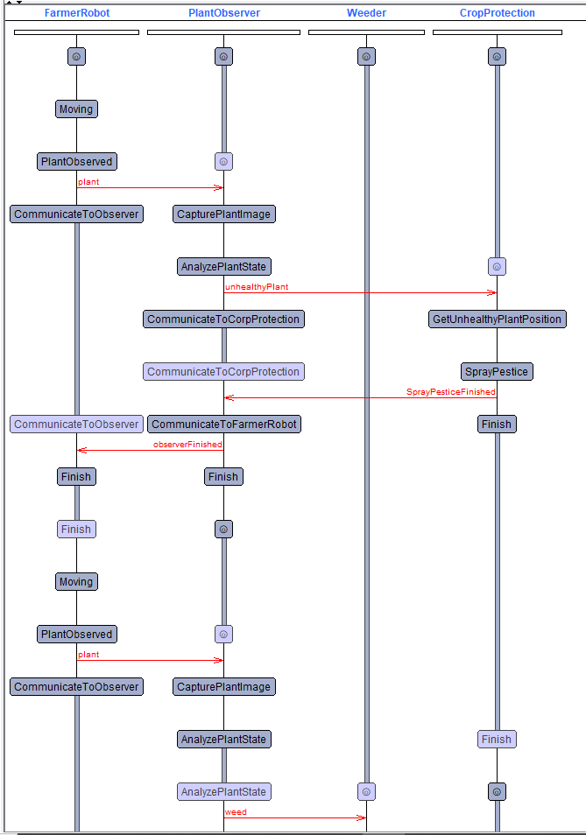
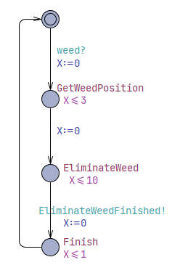
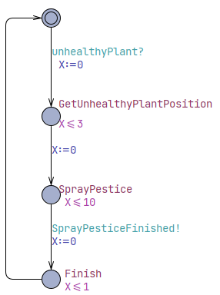
Roghieh Farajialamooti
Ghazaleh Hadian
Tural Hasanov
Gökcer Sönmezocak
Summer School
Embedded Systems Engineering
The Autonomous Future of Agriculture
MechatronicUML
Compononet
Verification
UPPAAL
Farmer Robot
Plant Observer
Weeder
Crop Protection

